Slide 1
Time Machine
Buffer over Flow Team

Slide 2
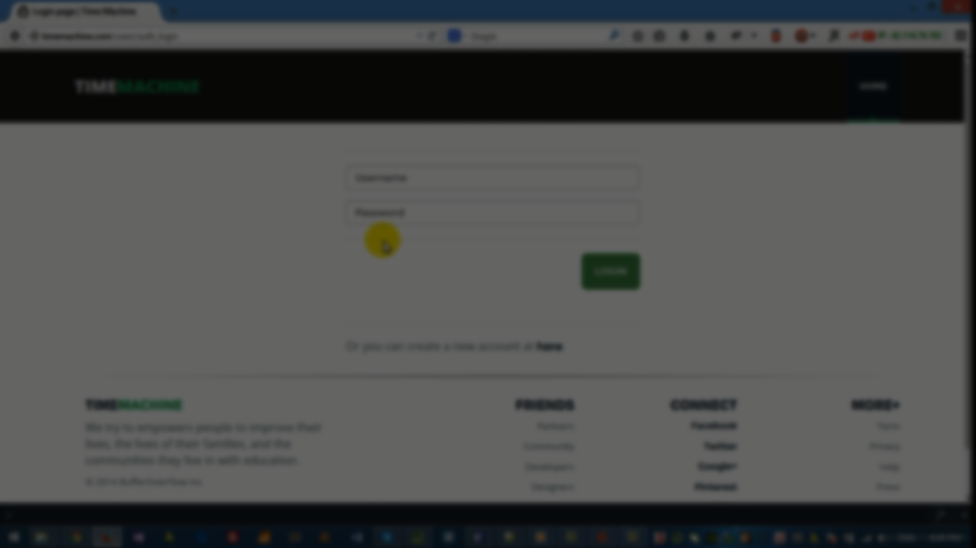
About the Project
Time Machine is a dynamic website implemented on Python Django, aiming at making it easier to keep track of students' learning schedule and gathering courses' information and materials in one place.

Slide 3

Our goals:
1. Make it easy to create/enroll in courses.
2. Interactive Timetables
3. Inspiring Courses' pages
4. Tracking learners' progress

Slide 4
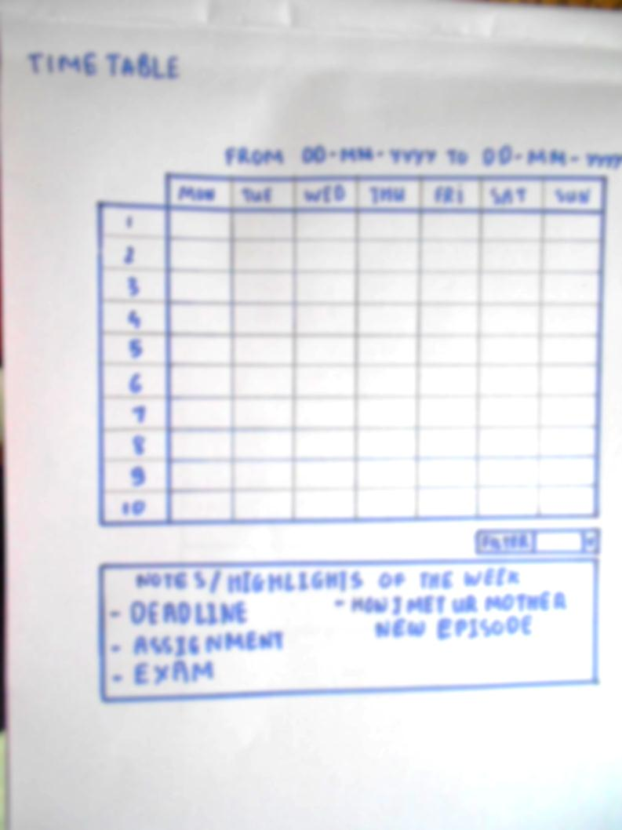
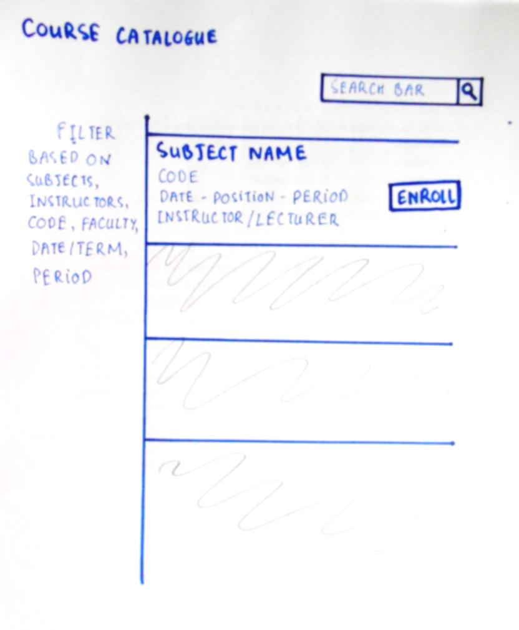
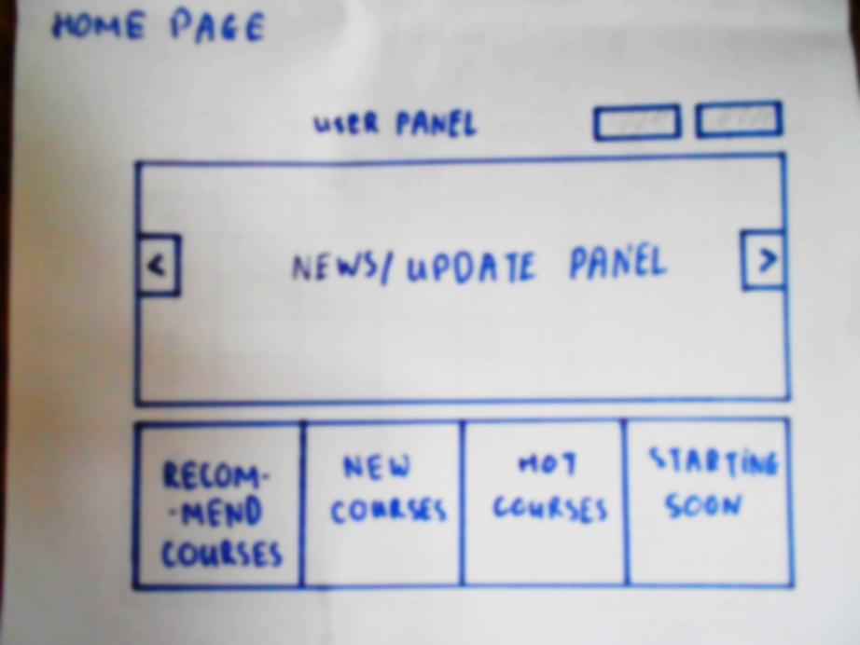
Paper Mockup
Prototyping

Slide 5
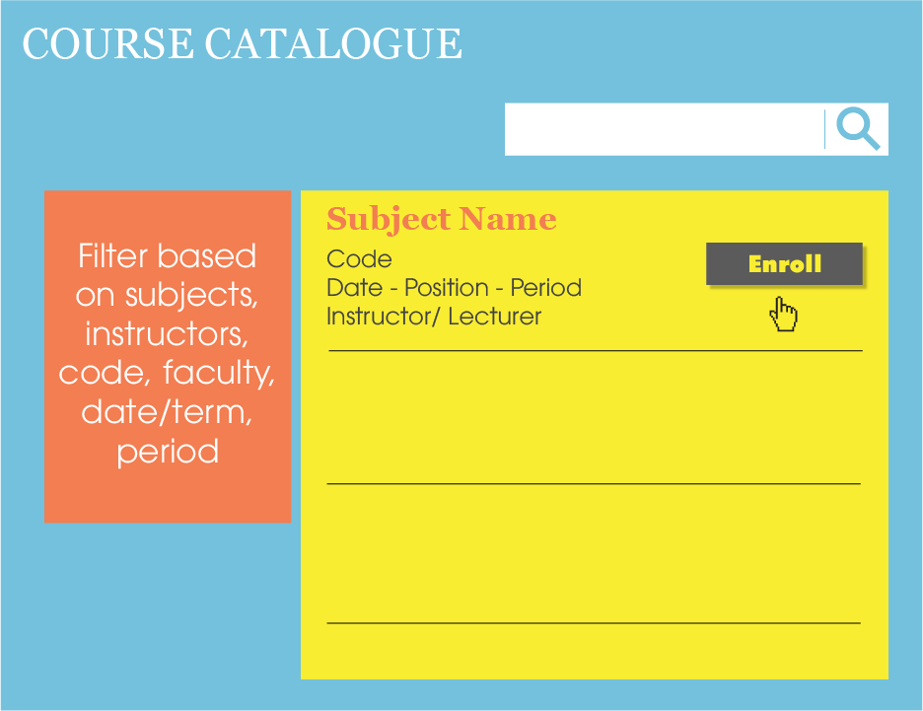

Slide 6
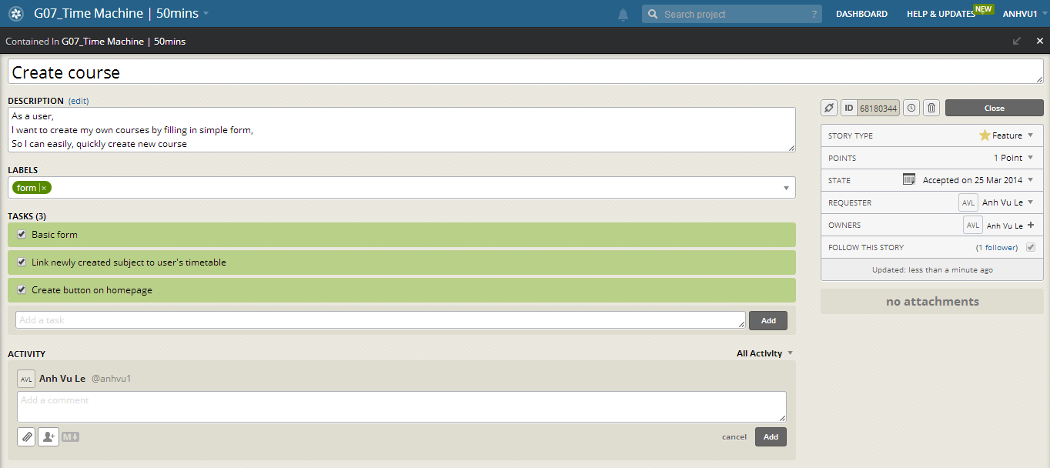
User Story #1

Slide 7
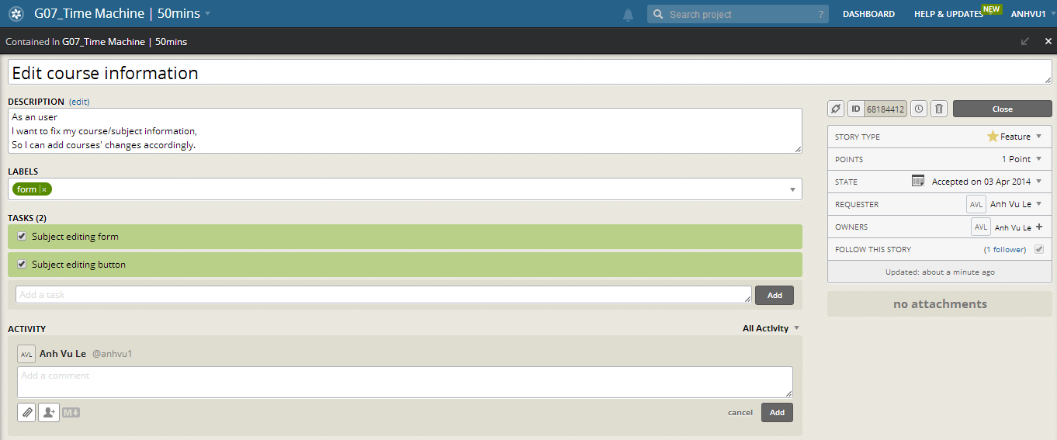
User Story #2

Slide 8
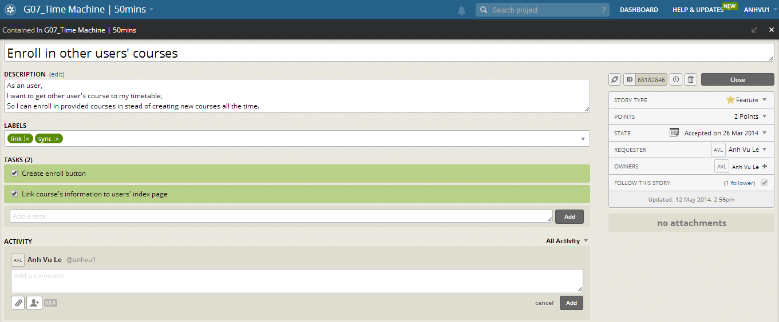
User Story #3

Slide 9
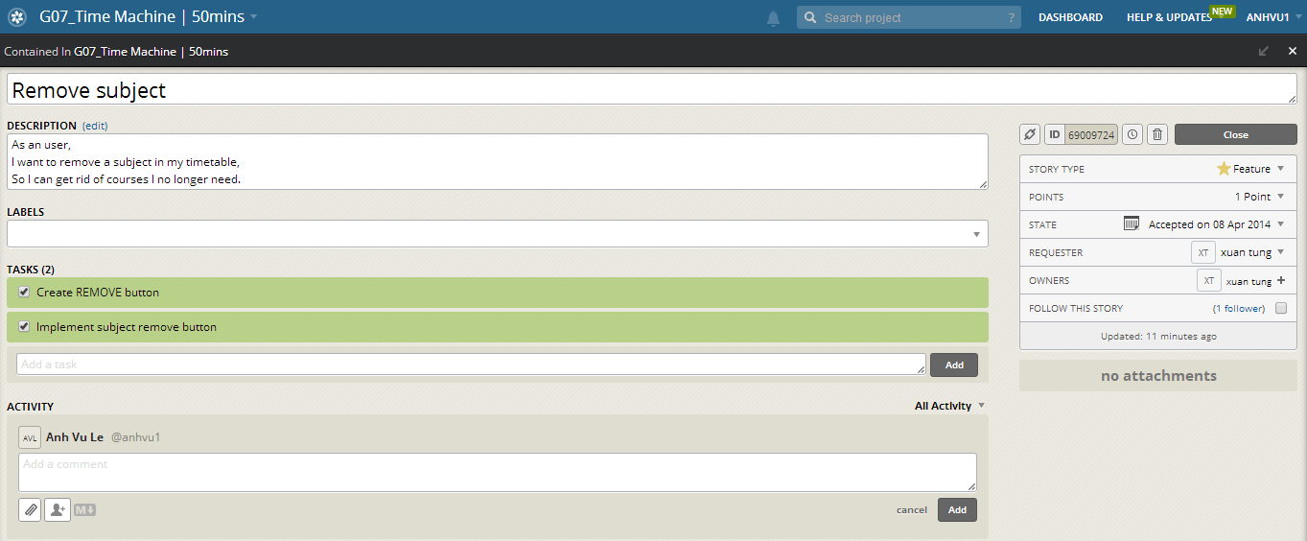
User Story #4

Slide 10
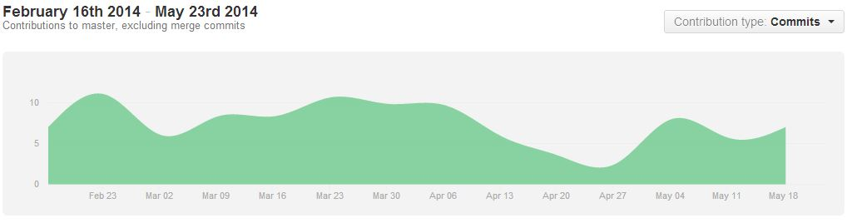
Contributor
Github Analysis

Slide 11
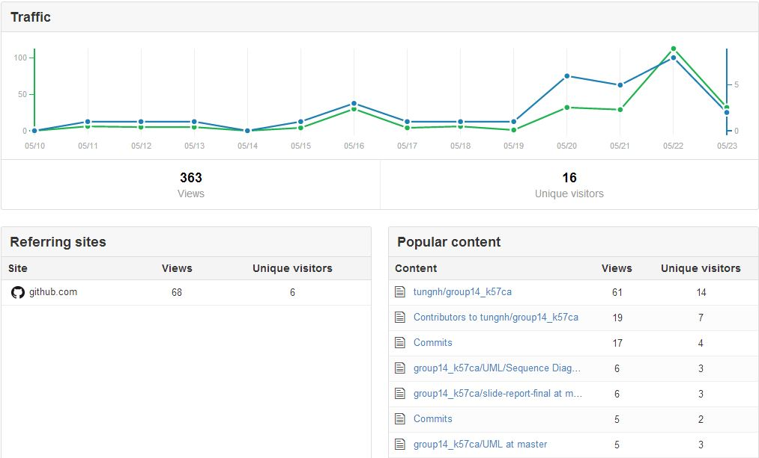
Traffic
Github Analysis

Slide 12
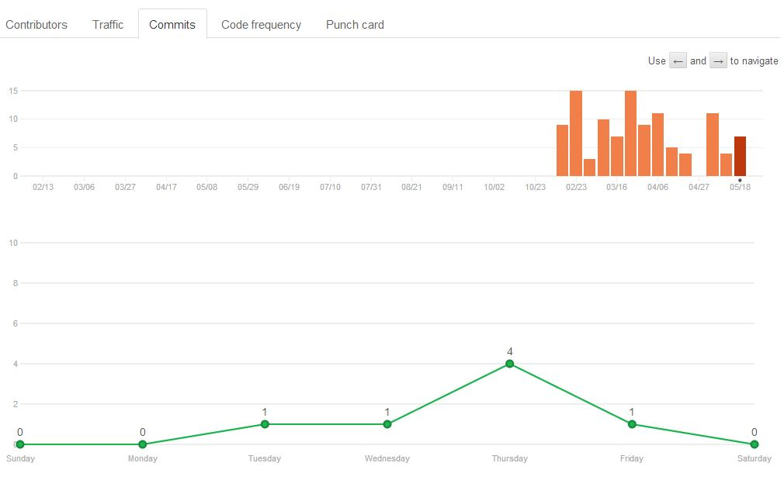
Commits
Github Analysis

Slide 13
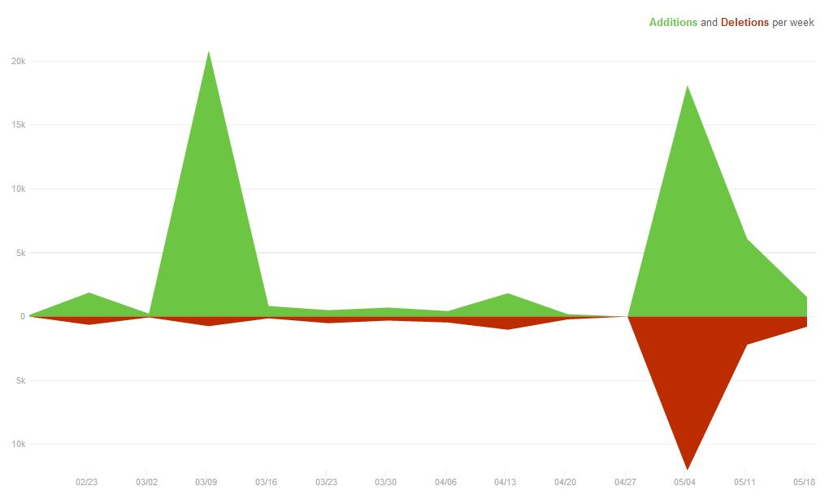
Code Frequency
Github Analysis

Slide 14
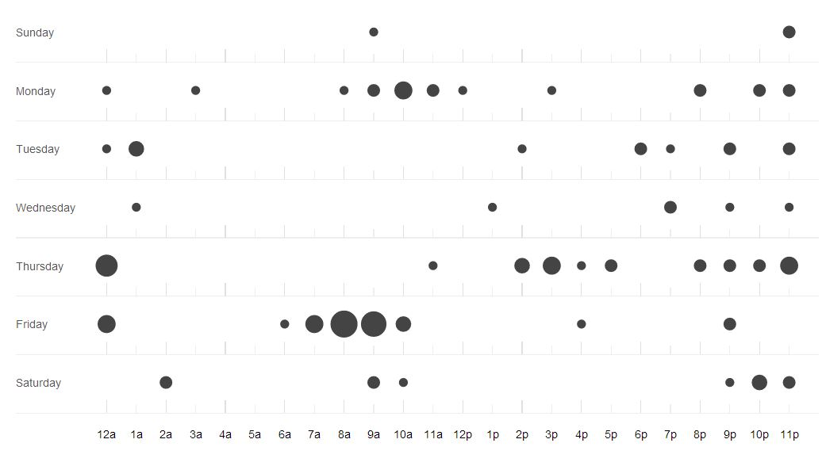
Punch Card
Github Analysis

Slide 15
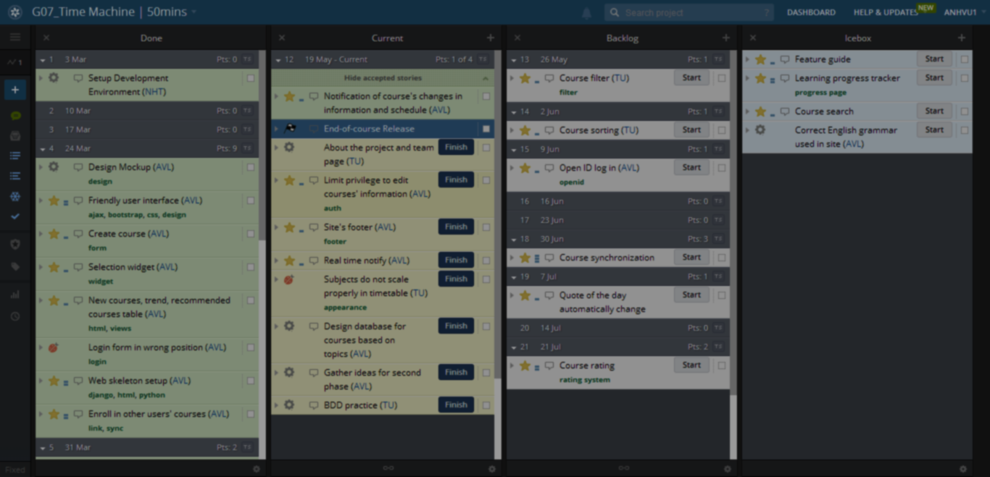
39 stories, 19 finished

Slide 16
Each story is short, contains 3 standard parts with focus on comprehensiveness

Slide 17
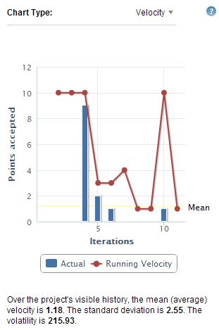
Velocity
Pivotal Tracker Analysis

Slide 18
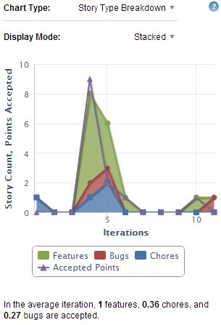
Story Type Breakdown
Pivotal Tracker Analysis

Slide 19
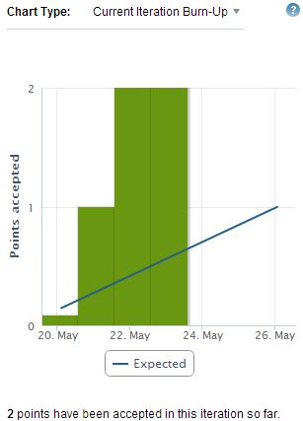
Current Iteration Burn-up
Pivotal Tracker Analysis

Slide 20
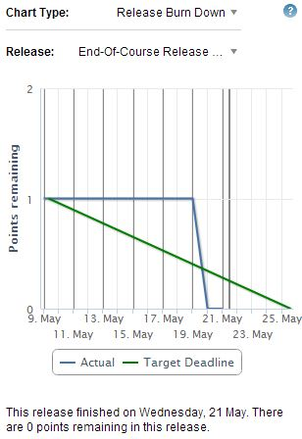
Release
Pivotal Tracker Analysis

Slide 21
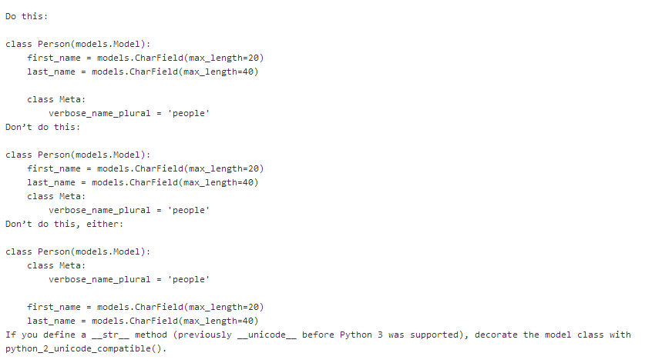
Following PEP = Python Enhancement Proposal
Coding Style

Slide 22

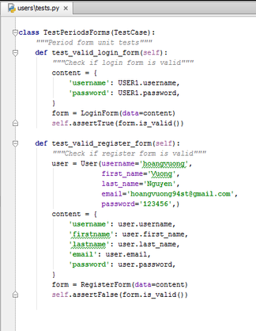
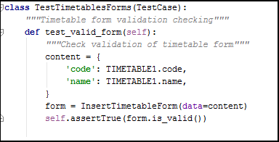
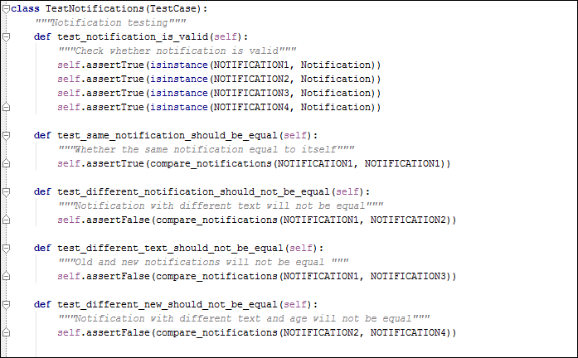
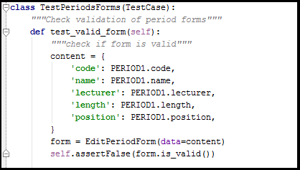
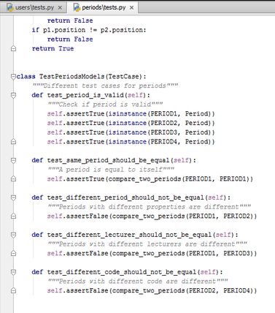
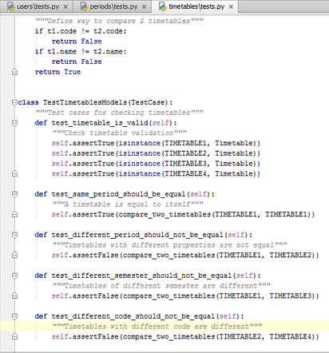
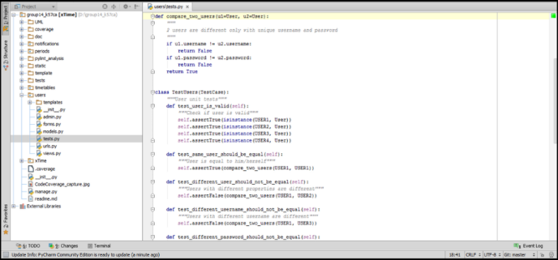
Test

Slide 23
Every module has tests!
Every test has comprehensive name & comment on what it does

Slide 24
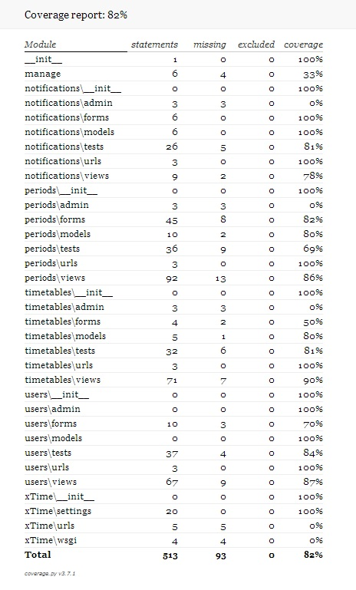
Code Coverage Report

Slide 25
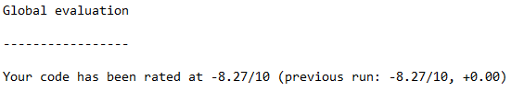
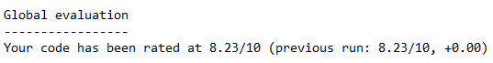
Reactor/Analysis
BEFORE
AFTER

Slide 26

Common Mistakes
Reactor/Analysis
Missing doc-string
Invalid-name
Line-too-long
Bad-indentation (Really annoying!!)

Slide 27
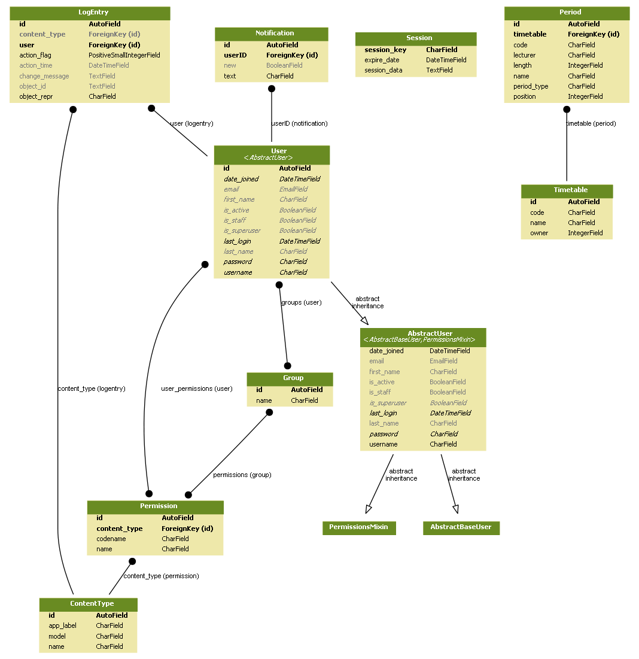
Model Diagram

Slide 28
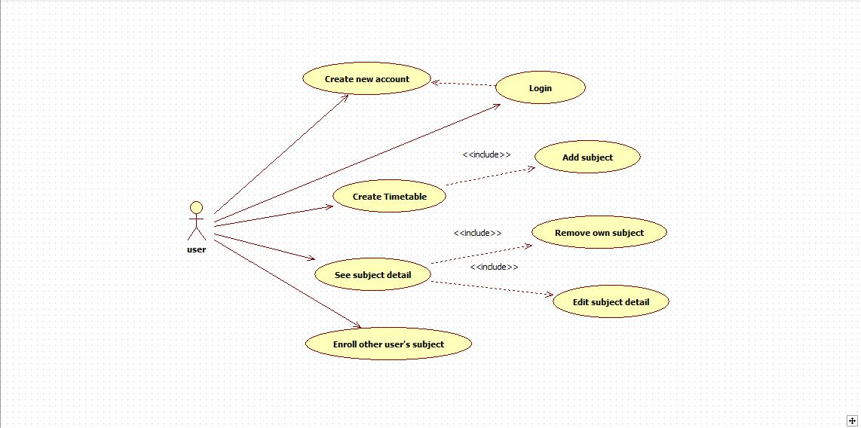
Use Case Diagram

Slide 29
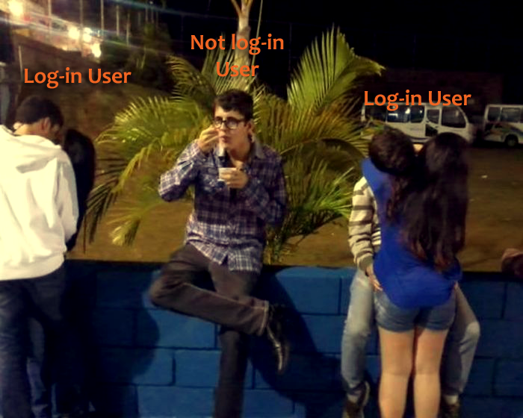
Use Case visual illustration

Slide 30
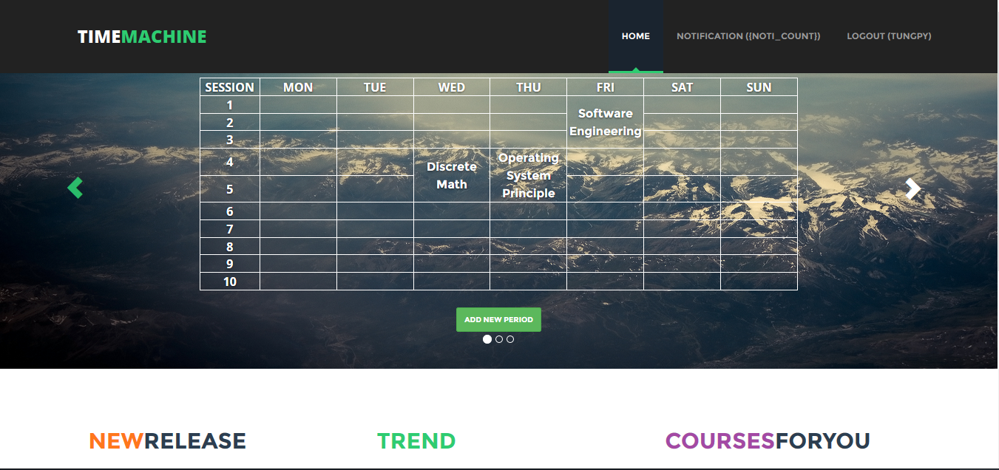
Final Product

Slide 31
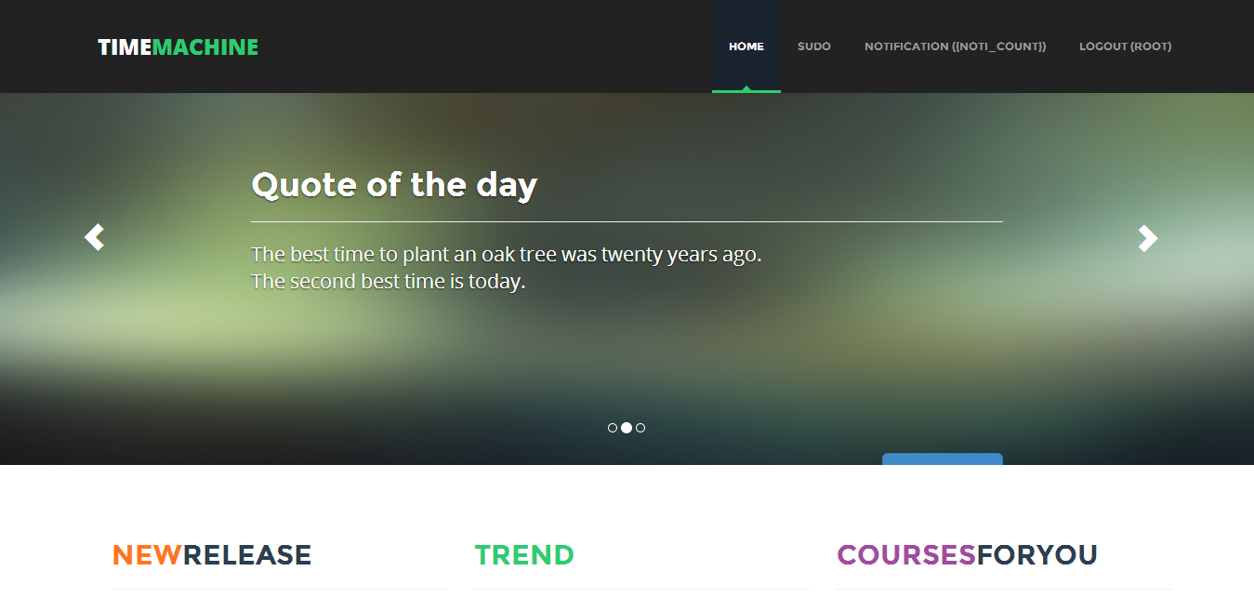
Final Product

Slide 32
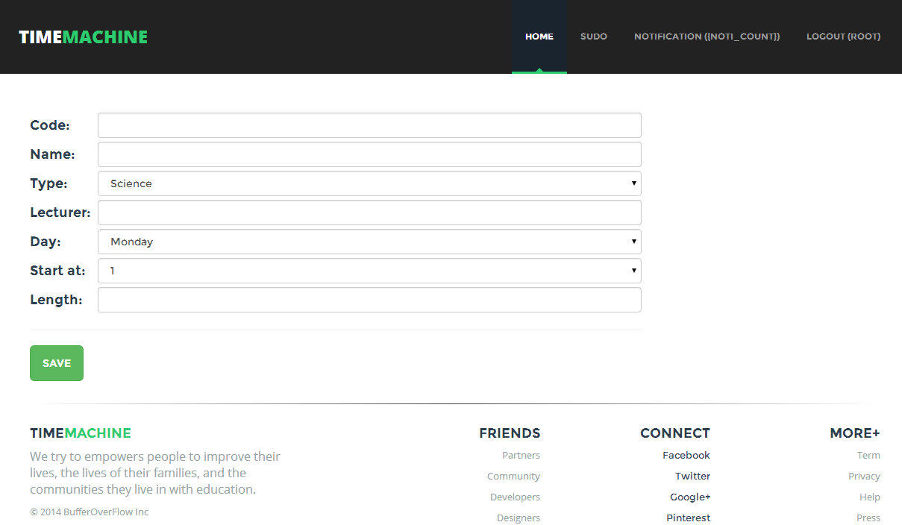
Final Product

Slide 33
Final Product
HOW TO USE ?

Slide 34

Final Product

Slide 35


